Slide 1
Mining Readiness Strategy
FINAL DRAFT
Prepared by MNP LLP for the City of Thunder Bay and the
Community Economic Development Commission (CEDC)
February 11, 2021
Ambassadors Northwest
Suite 701, 34 Cumberland St. N.
Thunder Bay, ON P7A 4L6 gotothunderbay.ca

Slide 2
Introduction
A guiding framework for the City of Thunder Bay to support the growing Northwestern Ontario mining sector
The City of Thunder Bay and the Community Economic Development Commission (CEDC) engaged MNP and TBT Engineering to develop a Mining Readiness Strategy focused on regional developments over the next ten years (2020 to 2030). The report focuses primarily on:
Business Development in Supply and Services: Maximizing exploration and mining service and supply opportunities for Thunder Bay, including connecting directly with the 6 mines and 15 exploration managers, identifying indirect and induced businesses and gaps in the supply chain.
Workforce Training and Development: Develop an understanding of positions required by mines now and in the future, assess existing college, university and trade programs and how to address any gaps.
Transportation and Electrical Infrastructure: Identify road, port and airport access and electricity requirements and constraints for the 15 exploration sites.
Economic Impact of New and Existing Mine Developments for Thunder Bay: Estimate the contribution to Thunder Bay’s economy by
the 6 producing mines and 15 exploration projects.
Research and Development: Identify potential technology advances and partnerships with local education and research centers.
Identifying Gaps and Barriers to Exploration and Mine Development in Northwestern Ontario.
The report concludes with strategic recommendations that the CEDC can implement to support the exploration and mining sector in the City of Thunder Bay and Northwestern Ontario.
2

Slide 3
Approach and Methodology
3

Slide 4
Regional Mining Overview
Ontario
Currently the largest producer in Canada of gold, platinum group metals, and nickel. Second largest producer of copper.
The value of mineral production in Ontario has consistently exceeded
$10 billion since 2014, and reached a
value of $10.7 billion in 2019.
Exploration expenditures between
$517 to $585 million over the last three years.
Estimated 26,000 direct jobs and 46,000 indirect jobs in mineral processing and mining supply and services in Ontario.
In 2020, Ontario had 40 operating mine sites (20-gold mines, 9-base metal mines 1-iron mine and 1- platinum group metal mine).
4

Slide 5
Regional Mining Overview
Northwestern Ontario – Distribution of Metals by Major Exploration Sites and Active Mines
Total Count
6
15
6
Nickel-Copper-PGE
1
Existing Operating Mines
Primarily gold mines, and one palladium mine.
Graphite
1
Lithium
3
15
Palladium
1 3
Major Exploration Sites
Primarily gold, palladium and lithium.
Gold
5
7
0 5
Quantity of Operating Mine Sites
10 15 20
Quantity of Major Exploration Sites
25
5

Slide 6
Regional Mining Overview
Northwestern Ontario – Historic Active Operating Mine Production (Gold and Palladium)
1,200,000
242,000
208,000
45,000
Ounces of Gold and Palladium
1,000,000
790,000+
158,000
800,000
208,000
227,000
257,000
261,000
227,000
Average Ounces of Gold Produced per Year
Between 5 current gold mines.
200,000+
600,000
37,000
236,000
205,000
27,000
257,000
3,000
140,000
235,000
400,000
171,000
207,000
196,000
213,000
324,000
276,000
277,000
200,000
209,000
150,000
Average Ounces of Palladium Produced per Year
By 1 current palladium mine.
0
2016 2017
Red Lake Mine (Gold) Musselwhite Mine (Gold) Sugar Zone Mine (Gold)
*2020 production value is estimated.
2018 2019 2020*
Hemlo Mine (Gold)
Rainy River Mine (Gold)
Lac des Iles Mine (Palladium)
6

Slide 7
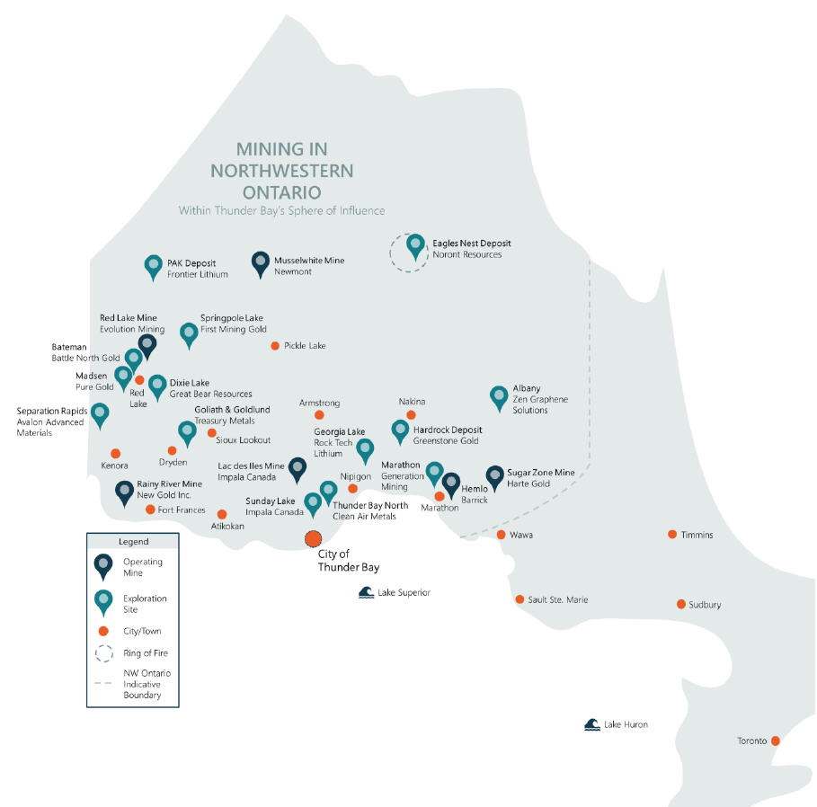

Slide 8
Mining Industry Stakeholder Feedback
Top Interview Themes
The CEDC is perceived by mining industry stakeholders as a key facilitator for business
1
introductions and sharing knowledge about economic development opportunities and support.
2
City/CEDC needs to advance their marketing and communications strategy to emphasize that Thunder Bay is a full-service hub for Northwestern Ontario.
3
Exploration and mining companies will prefer to buy local if their supply chain staff are aware of the local businesses which are qualified to deliver the needed supplies and services.
4
There is an emerging opportunity for critical mineral processing and support directly within the municipal boundaries of Thunder Bay.
5
There is a near-term great need for skilled trades and numerous types of support services
roles as new mines are constructed and begin operations.
8

Slide 9
Mining Industry Stakeholder Feedback
Top Interview Themes
6
A tailored strategy to support local workers and Indigenous community members gain the job skills along with the logistical support to get to the work sites is needed.
The city of Thunder Bay has abundant municipal infrastructure to support growth in the regional mining industry, but the broader northwest regional infrastructure has some significant challenges with road and electricity supply.
7
8
Thunder Bay is currently receiving significant economic benefits due to the mining industry
and is well perceived and positioned to benefit from the forecasted increase in mining activity.
9
All mining companies are willing to partner with local research facilities if the opportunity arises.
10
Extended timelines for permitting and approvals is seen as the major impediment to
advancing mine development.
9

Slide 10
Mining Supply and Services
Business Development in Thunder Bay – Business Type Focus Areas
Proximity to Mines
Local distribution centers.
Transportation and logistics services (e.g.
trucking).
Equipment and parts service centers.
General mine support services (e.g. security,
transportation, cleaning, catering, health, etc.).
Ground support materials
Workforce Training
Skilled trades training
centers.
Mining skills training
centers.
Life skills and career development services.
Critical Minerals
Chemical processing plants for critical mineral processing (e.g. lithium,
graphene).
Available Land
Promote available commercial and industrial land available in the city.
(e.g. shotcrete).
10

Slide 11
Workforce Training and Development
Northwestern Ontario Estimated 20-Year Employment Projection
3,600+
Mine Operations
Jobs in 2020
Estimated for the 6 operating mines in Northwestern Ontario.
100%
Increase in Mine Operations Jobs
Estimated to peak at 7,400+ total positions.
8,000
7,000
6,000
5,000
4,000
3,000
2,000
1,000
0
No. of Jobs
2,000+
Peak Construction Jobs in 2023
Estimated for the 15 major exploration sites in Northwestern Ontario.
7,000+
Peak Mining Jobs between 2023-2028
Estimated jobs required for construction and operation of new and existing mines.
No. of Existing Operations Jobs
No. of New Operations Jobs
10

Slide 12
Workforce Training and Development
Northwestern Ontario Estimated Mining Occupation Distribution (Current and Peak Levels)
Human Resources and Financial Occupations
237
Support Workers
325
Technical Occupations
239
2X
245 ₄₈₄
Supervisors, Coordinators, and Foremen
Professional and Physical Science Occupations
248
255
503
Operations Job Growth
Estimated around 2026 when all six current operating mines are still in production and multiple major exploration sites have converted to operating mine sites.
311
319
630
Trades Occupations
402
413
815
Production Occupations
904
881
1,785
Other Occupations
1,329
1,295
2,625
0 1,000 2,000
No. of Operations Jobs
3,000
No. of Current Operations Jobs (2020) No. of New Operations Jobs (2026, 2027) No. of Peak Operations Jobs (2026, 2027)

Slide 13
Transportation and Electrical Infrastructure
Access Road Requirements
Of the 15 exploration sites reviewed, 60 percent had minimal or moderate access road construction requirements, due mostly to their advantageous location close to the major highway network in Northwestern Ontario. Sites requiring major construction include:
Access to the Ring of Fire.
Realigning existing Highway 11 road and electricity infrastructure that is currently passing through the site.
Construction of all-season roads to improve current access restrictions of air travel and winter road only access (Frontier Lithium’s PAK project, and First Mining Gold’s Springpole Lake project).
N/A 13%
Major 27%
Minimal
20%
Moderate 40%

Slide 14
Transportation and Electrical Infrastructure
Electricity Supply Requirements
Of the 15 exploration sites reviewed, 53 percent had minimal or moderate electricity infrastructure requirements, due to their proximity to nearby transmission lines. Sites requiring major electricity infrastructure construction include:
Multiple sites requiring over 25 km of new transmission lines.
Multiple sites requiring power plants to be built due to lack of available local transmission lines or capacity.
N/A 13%
Minimal 13%
Major 34%
Moderate 40%

Slide 15
Transportation and Electrical Infrastructure
Electricity Demand Projection – Northwestern Ontario Total Impacts
600
190 MW
500
Peak Power Demand (MW)
Estimated Current Operating Mine
Electricity Demand
Levels expected to be maintained until 2027.
400
300
180%
200
100
Estimated increase in Electricity Demand from New Mines in 2026
Levels expected to increase from 190 MW present day amount to over 540 MW.
0
Total Existing Demand of 6 Mines
Total New Demand of 15 Exploration Sites

Slide 16
380%
Transportation and Electrical Infrastructure
Electricity Demand Projection – Regional Impacts
160
140
120
100
80
60
40
20
0
Estimated Electricity Demand Growth in Marathon-Greenstone
From 3 new major exploration sites.
220%
Peak Electricity Demand (MW)
84
60
116
40
Estimated Electricity Demand Growth in Red Lake
From 4 new major exploration sites.
57
50
30
37
30
80-150%
20
12
10
Marathon- Red Lake Greenstone
Fort Frances
Thunder Bay
Northern
Dryden
Kenora
Estimated Electricity Demand Growth in Fort Frances, Thunder Bay and Northern Regions
From 6 new major exploration sites.
Future Regional Peak Demand Required by Exploration Sites Current Regional Peak Demand of Operating Mines

Slide 17
Economic Impact
Projected Mining Output for Current Operating Mines and Major Exploration Projects
Current Operating Mines
Major Exploration
1,400,000
1,200,000
1,000,000
800,000
600,000
400,000
200,000
0
1,400,000
1,200,000
1,000,000
800,000
600,000
400,000
200,000
0
Production (Ounces)
Ounces/Tonnes
Palladium Production (Oz) - Projected Gold Production (Oz) - Projected
Total Production - Precious Metals (Ounces) Total Production - Other (Tonnes)

Slide 18
Economic Impact
Estimated Total Direct, Indirect and Induced Output for Northwestern Ontario
Economic Output is the total gross value of goods and services produced by a given organization, industry or project, measured by the price paid to the producer. This is the broadest measure of economic activity.
Direct impacts are changes that occur in “front-end” businesses that would initially receive expenditures and operating revenue as a direct consequence of the operations and activities of a facility.
Indirect impacts arise from changes in activity for suppliers of the “front-end” businesses.
Induced impacts arise from shifts in spending on goods and services as a consequence of changes to the payroll of the directly and indirectly affected businesses.
$10,000
$8,710
$7,940
$8,000
$5,910
$6,000
$ Million
$4,370
$4,000
$2,620
$2,000
$0
2019
2020
Average 2021 Average 2026 Average 2029
to 2025 to 2028
Advanced Stage Exploration Projects - Operations Advanced Stage Exploration Projects - Construction Operating Mines
to 2030

Slide 19
Strategic Recommendations
Main Focus Areas to be Implemented throughout 2021
The CEDC should act quickly to implement the strategic recommendations with completion targets by the end of 2021.
Leverage technology and digital media by enhancing the CEDC Mining website, allowing ease of access to contemporary information and facilitate the exchange of information and data.
Develop or expand on the CEDC mining readiness Marketing and Communications plan to ensure the Thunder Bay is widely known as the node for facilitation, collaboration, training and information of mining related services.
Advanced facilitation and knowledge transfer about the regional Mining Supply and Services offerings, making
prospective clients and companies aware of who’s in the region and able to support the growing mining industry.
Promote Thunder Bay as the Workforce Training and Development hub for mining sector and inform the education and training associations of what types of jobs are needed in the future.
Improve the regional mining industry stakeholders’ awareness (e.g. electricity planning and infrastructure organizations, exploration and mining companies, and provincial and federal government) of the Transportation and Electrical Infrastructure needs and planned or in-progress projects.
Evaluate strategic incentives and municipal infrastructure priorities which incentivize Business and Economic Development for the Mining Sector.
19

Slide 20
Strategic Recommendations
Estimated Implementation Plan
GANTT: Thunder Bay Mining Readiness Strategy
START
2021
NO. | ACTION | DATE | TIMELINE | Q1 | Q2 | Q3 | Q4
1.1 | Implement strategic actions within next 12 mths | 1 | 4
2.1 | Digital media and website enhancement plan | 1 | 2
3.1 | Facilitate industry introductions | 1 | 4
3.2 | Provide quarterly dashboard emails | 2 | 1
3.3 | Case studies of successful indigenous relations | 3 | 1
3.4 | Promote Thunder Bay as a full-service community | 1 | 4
3.5 | Regular government communications on mining | 1 | 4
4.1 | Promote existing mining sector supply/services | 1 | 4
4.2 | Communicate/develop critical mineral processing | 2 | 2
4.3 | Enhance existing mining supply/service directory | 2 | 3
4.4 | Mining sector supply chain info on CEDC website | 2 | 2
4.5 | Available vacant land info on CEDC website | 2 | 1
5.1 | Gather skills gaps and current/future job data | 1 | 4
5.2 | Facilitate working groups with trainers/educators | 2 | 3
5.3 | Promote mining skills, positions and training | 1 | 4
5.4 | Provide information on local education/training | 2 | 2
6.1 | Gather data on site infrastructure requirements | 3 | 1
6.2 | Communicate infrastructure gaps and barriers | 4 | 1
6.3 | Public updates on infrastructure initiatives | 3 | 2
6.4 | Prioritize updating the International Airport | 1 | 4
7.1 | Strategic incentives for attracting businesses | 1 | 4
7.2 | Prioritize municipal infrastructure developments | 3 | 2
7.3 | Develop/expand COVID-19 economic recovery | 1 | 4
20

