Slide 1
September 2018 FPInnovations Overview Forest Operations/Fibre Supply – Ontario Team

Slide 2
Dean Caron - Background
Born, raised and based in Kenora Ontario.
Honours Bachelor of Science Forestry Degree and Forest Technician Diploma from Lakehead University.
RPF Ontario.
Worked in BC (Interfor Tofino - Engineering), Alberta (Canfor Hines Creek - Planning) and Northwestern Ontario (Weyerhaeuser Ear Falls – Area Leader, Weyerhaeuser Kenora – Aboriginal Business Development Leader, Boise Cascade Canada (Resolute) Fort Frances/Kenora - Student).
Eight years with government (Ministry of Northern Development and Mines) doing economic development work (natural resources, First Nations and NOHFC evaluator).
Nearly 30 years in the forest industry (direct and indirect).
Been with FPInnovations since April of 2015 (Industry Advisor – Forest Operations/Fibre Supply).

Slide 3
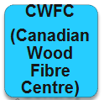
FPInnovations Created April 2007

Slide 4
FPInnovations, a global innovation organization
Not-for-profit world leader specialized in the creation of scientific solutions in support of the Canadian forest sector’s global competitiveness.
Unique forest R&D centre offering full value chain solutions, from forest management to consumer products.
More than 400 dedicated employees of which 200 are scientists/researchers.
World-class R&D facilities, pilot plants and satellite offices from coast-to-coast.
Annual operating budget of approximately $78 million.
Membership of approximately 210 throughout Canada, including industrial and government members (including OMNRF).
Many partnerships with colleges, universities and other institutions in Canada and abroad.
Notes:
Employees 551+ corp. (Paprican: approximately 202 employees = 68 scientists, 100 technologists, 25 support staff, 9 managers; Feric: 100 = 68 chercheurs/techniciens spécialisés; 17 employés de soutien (adm, comm, VP, GM; 10 IAs; Forintek 213: West = 104 employees: 22 scientists and 18 technologists and 30 ES / East= 105 employees (37 scientists and 26 technologists and 21 IAs); CWFC: around 70 employees, of which 61 are scientific and support (13 researchers, 22 professionals and 24 technical supports, 2 management) and 5 are knowledge personnel.
Transfer knowledge personnel: Feric 10; Forintek 30; Paprican???; CWFC 5
Forintek East: Forintek Québec has plant and lab installations that are used for 10 different research areas (although not divided into specific labs): Adhesive, Environment, Biotechnology, Nanotechnology, Structure and materials evaluation, Lumber, Drying, Pilot plant, Biorefining, Resource assessment
Members: Forintek 250; Paprican 16; Feric 92+24=116 for a total of 382
Governments (12): NRCan, Alberta, British Columbia, Manitoba, New Brunswick, Newfoundland and Labrador, Northwest Territories, Nova Scotia, Ontario, Quebec, Saskatchewan, Yukon Territory

Slide 5
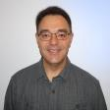
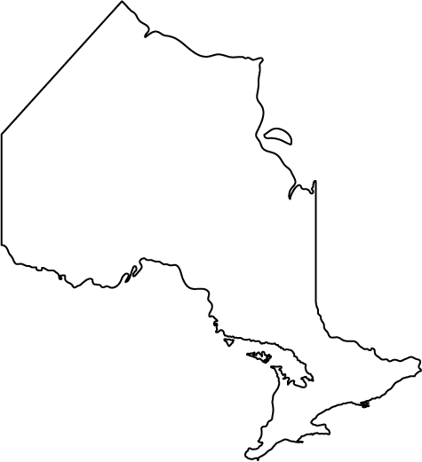
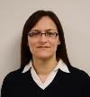
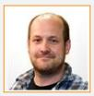
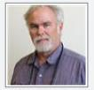
FPInnovations Ontario Team
FPInnovations supports the Canadian forest products sector through applied research, new technology, continuous improvement, and business intelligence - in forest operations, wood products, pulp & paper, and bio-products industries. A private not-for-profit funded through industry and government memberships, FPInnovations delivers industry-directed R&D to its members through its laboratories and 500+ employees.
In Ontario, FPInnovations has a strategic partnership with provincial and federal funders to help create and stimulate economic development opportunities in forestry, milling, manufacturing, engineered wood products, and consumer wood products - through the implementation of science, technology, business intelligence and market analysis for small and medium enterprises (SME’s).
Technical support from FPInnovations Ontario Team:
Level I: Technical Enquiries Up to ½ day of complimentary service in response to telephone and e-mail enquiries about forestry or wood products operations, products, and markets.
Level II: Direct Technical Support (DTS) Project Up to five days of free technical service to assist SMEs in developing new products and processes, and, in implementing new technologies.
Level III: Process & Product Development (P & PD) Study More in-depth project to pursue new business ideas through technical investigation and market research. Upon approval by the Ontario Technical Advisory Committee, studies can be funded up to 75% and a maximum of $20,000.
Dave West
Industry Advisor
Business Analysis
and Development
Thunder Bay
Dean Caron, R.P.F.
Industry Advisor
Forestry and Forest
Operations
Kenora
John Pineau
Provincial Leader
Mattawa
Kenora
Dryden
Thunder Bay
Timmins
Sault Ste. Marie
Walford
Mattawa
Kirsten Maki
Group Leader
BETC - Thunder Bay
* 5 additional staff at BETC
Ottawa
Glen Prevost
Junior Industry Advisor
Community
Bio Heat Intern
North Bay
Toronto
Mark Partington, RPF
Roads and Infrastructure
Researcher
Montreal
Dean Assinewe, R.P.F.
Industry Advisor
Indigenous Economic Development
Walford
Peter Hamilton, RPF
Forest Operations/Fibre Supply
Researcher
Montreal
Ken Koo
Industry Advisor
Engineered Wood and Building Systems
Toronto

Slide 6
Our Products and Services - Summary
Fee-based Research Services | Proprietary contract research for industry members and clients Non-proprietary (common-good) contract research for government members and clients
Specialized Testing & Analytical Services | Pilot plant facilities; special chemical analyses; environmental analyses; etc.
Specialized Tools | For forest operations (FPSuite) For sawmills/panel mills (Optitek, Pressman) For pulp and paper mills (Control Loop Monitor)
Specialized Training, Extension and Workshops - Contractor Business Skills, Operations Diagnostic, Road Construction/Maintenance, Silviculture Planning, Fire & more
Market Intelligence and Global Trends

Slide 7
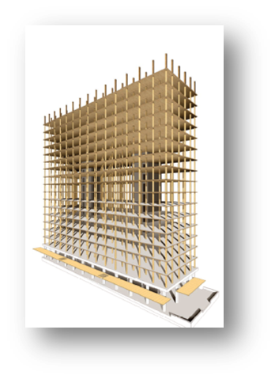
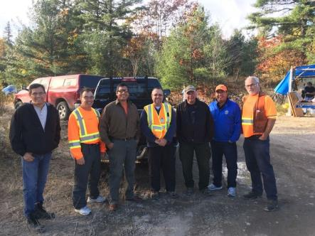
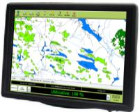
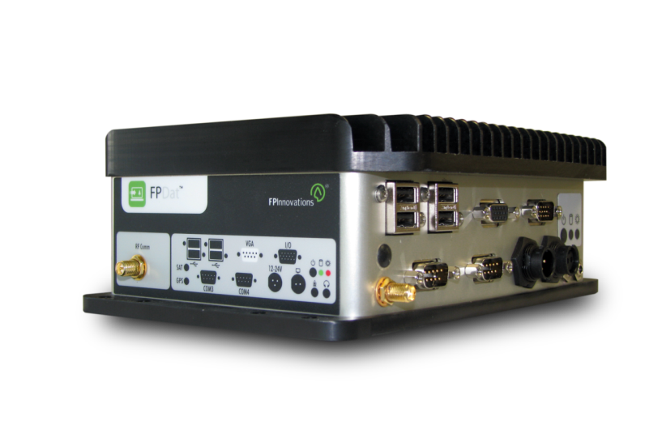
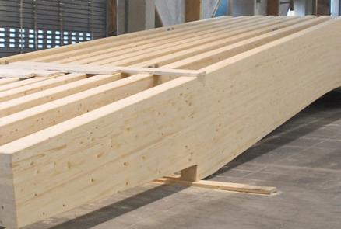
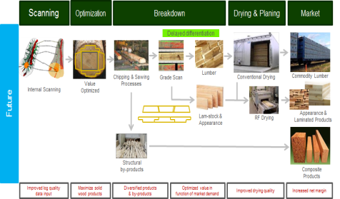
Ontario Forest Products Innovation Initiative (OFPII) (2018-21) Themes and Focus
Forest Operations Modernization
Building Indigenous Capacity
Innovative BioProducts
SM² (Smart Manufacturing)
Mid Rise and Tall Wood

Slide 8
My Role – Industry Advisor Forest Operations (Ontario)
I cover the entire province.
Finding innovative, practical, and cost-effective solutions.
When I get presented with a challenge, issue or opportunity from a client:
Despite nearly 30 years experience in the industry, I often have to go to one of the 200 scientists and researchers (specialists) we have for advice/solutions.
If our researchers do not have a solution, we can then study the challenge, issue or opportunity and come up with a solution.
Notes:
Employees 551+ corp. (Paprican: approximately 202 employees = 68 scientists, 100 technologists, 25 support staff, 9 managers; Feric: 100 = 68 chercheurs/techniciens spécialisés; 17 employés de soutien (adm, comm, VP, GM; 10 IAs; Forintek 213: West = 104 employees: 22 scientists and 18 technologists and 30 ES / East= 105 employees (37 scientists and 26 technologists and 21 IAs); CWFC: around 70 employees, of which 61 are scientific and support (13 researchers, 22 professionals and 24 technical supports, 2 management) and 5 are knowledge personnel.
Transfer knowledge personnel: Feric 10; Forintek 30; Paprican???; CWFC 5
Forintek East: Forintek Québec has plant and lab installations that are used for 10 different research areas (although not divided into specific labs): Adhesive, Environment, Biotechnology, Nanotechnology, Structure and materials evaluation, Lumber, Drying, Pilot plant, Biorefining, Resource assessment
Members: Forintek 250; Paprican 16; Feric 92+24=116 for a total of 382
Governments (12): NRCan, Alberta, British Columbia, Manitoba, New Brunswick, Newfoundland and Labrador, Northwest Territories, Nova Scotia, Ontario, Quebec, Saskatchewan, Yukon Territory

Slide 9
My Role – Member Relations, Industry Advisor Forest Operations
I support capacity building (with support from the National Fibre Supply Team).
Contractor Business Skills Workshop.
Forest Roads Grader Workshop.
Forest Operations Contractor Diagnostic.
Erosion and Sediment Control Workshop.
Many specific special projects associated with challenges/opportunities that clients experience.
I’m part of the Ontario Team and the National Forest Operations/Fibre Supply Team.
Notes:
Employees 551+ corp. (Paprican: approximately 202 employees = 68 scientists, 100 technologists, 25 support staff, 9 managers; Feric: 100 = 68 chercheurs/techniciens spécialisés; 17 employés de soutien (adm, comm, VP, GM; 10 IAs; Forintek 213: West = 104 employees: 22 scientists and 18 technologists and 30 ES / East= 105 employees (37 scientists and 26 technologists and 21 IAs); CWFC: around 70 employees, of which 61 are scientific and support (13 researchers, 22 professionals and 24 technical supports, 2 management) and 5 are knowledge personnel.
Transfer knowledge personnel: Feric 10; Forintek 30; Paprican???; CWFC 5
Forintek East: Forintek Québec has plant and lab installations that are used for 10 different research areas (although not divided into specific labs): Adhesive, Environment, Biotechnology, Nanotechnology, Structure and materials evaluation, Lumber, Drying, Pilot plant, Biorefining, Resource assessment
Members: Forintek 250; Paprican 16; Feric 92+24=116 for a total of 382
Governments (12): NRCan, Alberta, British Columbia, Manitoba, New Brunswick, Newfoundland and Labrador, Northwest Territories, Nova Scotia, Ontario, Quebec, Saskatchewan, Yukon Territory

Slide 10
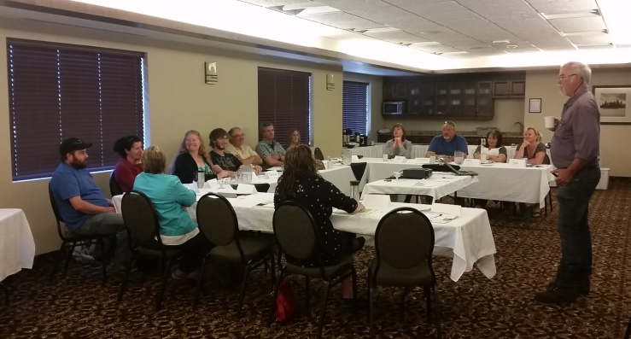
Contractor Business Skills Workshop
One day classroom session (five to seven hours).
Facilitated, interactive, investigation of key skill sets required to run a successful modern day logging operation.
Led by Peter Hamilton (former contractor and FPInnovation’s Senior Scientist) and / or myself.
Sessions are typically limited to 15 people.
Contractor Business Skills Workshop – Domtar Dryden 2015
Notes:
10 last year, about 40 in 4 years. Gaining in popularity.

Slide 11
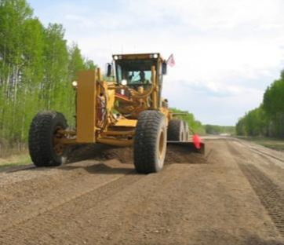
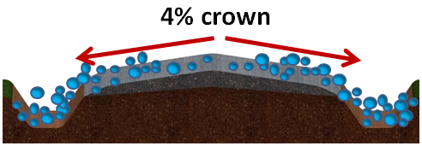
Forest Roads Grader Workshop
We offer a one and a half day workshop.
Two half days in the classroom (or one full day).
One half day in the field.
Limited to 15 people per session.
Delivered by myself.
Notes:
Over 25 workshops have been delivered to over 300 students since 2009.

Slide 12
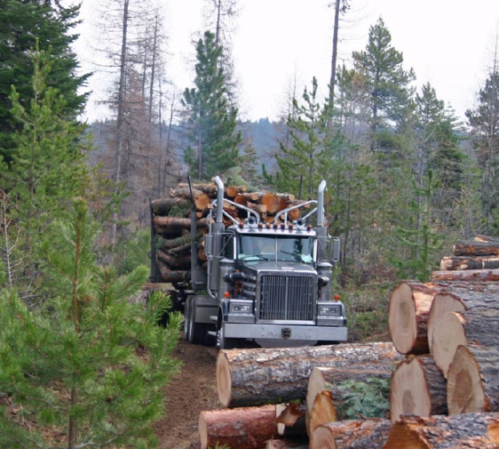
Forest Operations Contractor Diagnostic
Completed by senior FPInnovations staff (Peter Hamilton –FPInnovations Senior Scientist / former contractor) and myself.
Very unique and highly valuable initiative for contractors and companies.
Eight key business / operational criteria are evaluated.
Logging Contractor

Slide 13
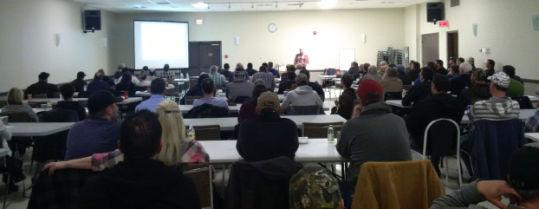
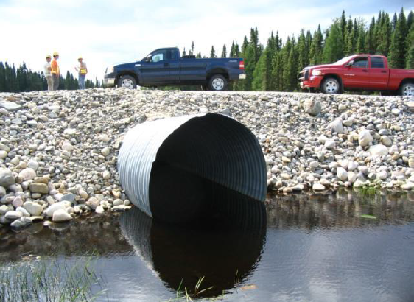
Erosion and Sediment Control Workshop
This approximate half day workshop can be delivered:
In the classroom only (can be a large class).
Combination in the classroom and in field (prefer small class).
In the field only (prefer small class).
Delivered by FPInnovations staff (Mark Partington - Roads Scientist and/or myself).
Erosion and Sediment Control Workshop in Thunder Bay – Resolute 2016

Slide 14
Other Possibilities
Introductory Indigenous Forest Operations Business Skills Workshop.
Bridge inspection workshops.
Road construction workshops.
Business coaching.
Business analysis.
Machine productivity and utilization data collection coaching.

Slide 15
Examples of FPInnovations Projects in Northwestern Ontario 2015 - 2018
Bridge Inspection Workshops (Kenora, Thunder Bay, Gravenhurst, Sudbury, Timmins, Wawa).
Forest Roads Grader Workshops (Marathon, Upsala, Atikokan, Ear Falls - municipal employees included, Whitesand First Nation, Dryden, Kenora).
Operational Block Planning Workshop (Kenora).
Roads workshop (Thunder Bay, Timmins).
Contractor Diagnostics (Upsala, Thunder Bay, Marathon, Kenora, Dryden, Red Lake, Sioux Lookout x2, Magnetawan).
Contractor Business Skills Workshops (Dryden, Kenora, Thunder Bay, Magnetawan).
Erosion and sediment control workshops (Thunder Bay, Sioux Lookout, Ear Falls).
Water crossing for field workers workshops (Thunder Bay, Atikokan).

Slide 16
Examples of FPInnovations Projects in Northwestern Ontario 2015 - 2018
FPDat showcase project (Dryden, Sioux Lookout).
Whitefeather sawmill study (Pikgangikum First Nation, Red Lake).
Pic River First Nation/Marathon opportunities for use of under utilized timber.
Combined Heat and Power (CHP) projects.
Engineered Wood Bridge Workshops (Kenora, Thunder Bay).
Community sawmill setup and production training/coaching (Pikangikum,Lac Seul).
Log truck driver project.
NOMA/FONOM project (capacity building for political leaders).
Coaching on collecting and utilizing productivity and utilization data.
Forest operations, log haul and silviculture business coaching.
Plus many more!

Slide 17
Upcoming Initiatives Fall/Winter (forest operations)
Introductory Indigenous Forest Operations Business Skills Workshop (pilot delivery).
Business coaching projects
Logging contractors
Haul contractors
Erosion and sediment control workshops
Timmins
Sudbury
Kapuskasing
Mattawa
Dryden
Kenora
Operations Diagnostics
Kenora SME Productivity Innovations and Tech Transfer Project
CWFC/FPI Events

Slide 18
Thank You!
Dean Caron RPF dean.caron@fpinnovations.ca
807-548-3098 (O), 807-464-4462 (C)

