Slide 1
CAPITAL CAMPAIGN

Slide 2
Description
By moving out of the shadows of the wooded Confederation College campus and into the open on the waterfront, the Gallery will open its doors to a larger public. Prince Arthur's Landing continues to transform the Thunder Bay waterfront into a world-class destination.
The 37,000 square foot building will feature a stunning vista of glass overlooking and reflecting the iconic Sleeping Giant and serve as a vibrant and stimulating meeting place
Residents and visitors can share in the exploration of art through exhibitions, gallery tours, education programs, public and private events and more
The new gallery will provide further stimulus to cultural, recreational and commercial growth in Thunder Bay.
Business and young professionals are attracted to communities with vibrant cultural programs and facilities.*
*Building the Case for Business Support of the Arts
A Study Commissioned by Business for the Arts
February 2015

Slide 3
Impact
The Gallery will provide $33M in direct economic impact during construction.
Once open, the Gallery's operation will generate $2.2M annually in direct and indirect impacts to the local economy
As a major tourist attraction, the Gallery will also generate an estimated $7M in annual visitor spending
Currently, the Gallery attracts approximately 26,000 visitors each year, including residents and tourists. Visits include exhibitions, education and special events.
It is estimated that number will increase to just over 71,000 visitors each year, made up of 26,000 tourists and 45,000 local residents.
The Gallery will also generate 9 new direct full-time (3 project based, 6 permanent) and 6 new direct part-time jobs.

Slide 4
Why?
Preservation and growth of the 1,600 piece, world-renowned permanent collection:
More space for appropriate storage
Greater environmental protection and restorative area
Increase exhibition space:
Opportunity to display more pieces from the permanent collection more often
Opportunity to host more and larger touring exhibitions

Slide 5
Why?
Continuation and growth of diverse public programming
High demand for art classes and workshops for schools and community, as well as rental space for private functions
Current space of one community room will grow to two art studios and one lecture theatre
Use of outdoor space near the gallery and throughout Prince Arthur's Landing
Improve visibility
Transition from solely destination to walk-in, increasing public engagement and prominence
Complement the existing and emerging cultural and recreational destinations at Prince Arthur's Landing

Slide 6
Why Business Supports the Arts*
Support provides a return on investment (ROI) and creates strong brand equity:
Consumers care about companies who have a strong relationship and connection to the community
63% of Canadian believe that businesses have an important role to play in supporting the arts
52% of Canadians indicate they have a more favorable attitude toward businesses that support the arts
34% of Canadians prefer attending arts events and venues, 29% sporting events and venues
Support also provides social return on investment (SROI):
Enhances community well-being and health
Creates a vibrant and attractive community appealing to new business and residents as well as visitors
Enhances the emotional and intellectual development of children
*Building the Case for Business Support of the Arts
A Study Commissioned by Business for the Arts
February 2015

Slide 7
Project Schedule
Architectural Design Phase
Design Development – approved in June, 2017
Construction Drawings – to be approved in October, 2018
Tendering – November 2018 – February 2019
Record of Site Condition Approval – February 2019
Construction Phase
Start – March 2019
Substantial Completion – November 2020
Commissioning – December 2020 to April 2021
Opening – estimated May 2021

Slide 8
Confirmed Project Funding to Date
PROJECT TOTAL | $33M
Federal Government - Cultural Spaces | $11.5M
City of Thunder Bay | $5M
Provincial Government - Northern Ontario Heritage Fund | $5M
FedNor | $3.5M
Fed, Prov, Mun - Architectural Design | $2.5M
AWE Capital Campaign | $2.1M

Slide 9
Levels of Support
LEVEL | AMOUNT
Visionaries | $250,000 +
Founders | $100,000 - $249,999
Champions | $50,000 - $99,000
Benefactors | $25,000 - $49,999
Builders | $10,000 - $24,999
Leaders | $5,000 - $9,999
Advocates | $2,500 - $4,999
Patrons | $1,000 - $2,499
Friends | $1 - $999
Gallery 1 – Curator’s Circle | $50,000
Gallery 2 – President’s Circle | $10,000
Gallery 3 – Director’s Circle | $25,000

Slide 10
Naming Opportunities
AREA | AMOUNT
Event Hall | $500,000
Turtle Entrance Plaza | $100,000
Lecture Meeting Room | $75,000
Art Classroom | $75,000
Gift Shop | $50,000
Art Classroom | $50,000
Elevator | $25,000
Art Walk | $25,000

Slide 11
Support Benefits
Permanent recognition in lobby Capital Campaign wall – innovative design and placement to be created by building architect and Generator Advertising
Recognition in Campaign communication and events – 2018-2020
Recognition in Building Opening communication and events – 2021
Ongoing recognition communication when the gallery is open
Pledge Period
2018-2022

Slide 12
“THIS IS A UNIQUE OPPORTUNITY FOR THE BUSINESS COMMUNITY TO BE INVOLVED IN AN EXCITING NEW INFRASTRUCTURE PROJECT THAT WILL ENHANCE THE QUALITY OF LIFE IN OUR COMMUNITY FOR GENERATIONS TO COME. IT WILL BRING THE GALLERY, THE WATERFRONT AND THE CITY INTO A NEW ERA.”

Slide 13
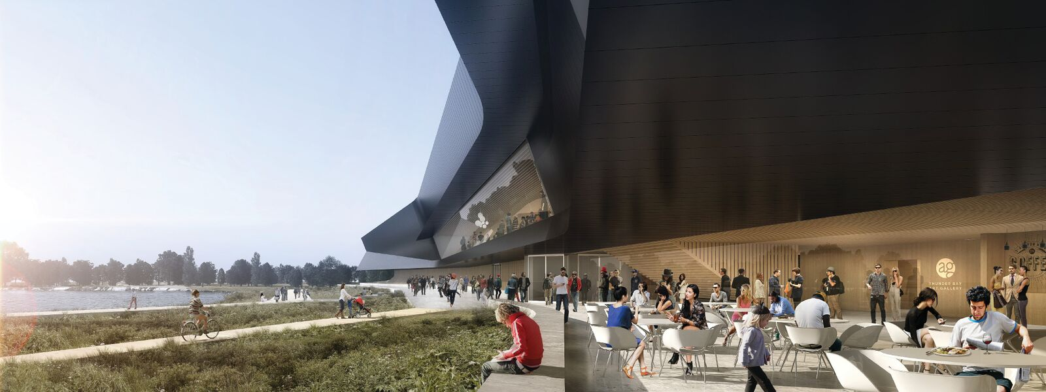

Slide 14
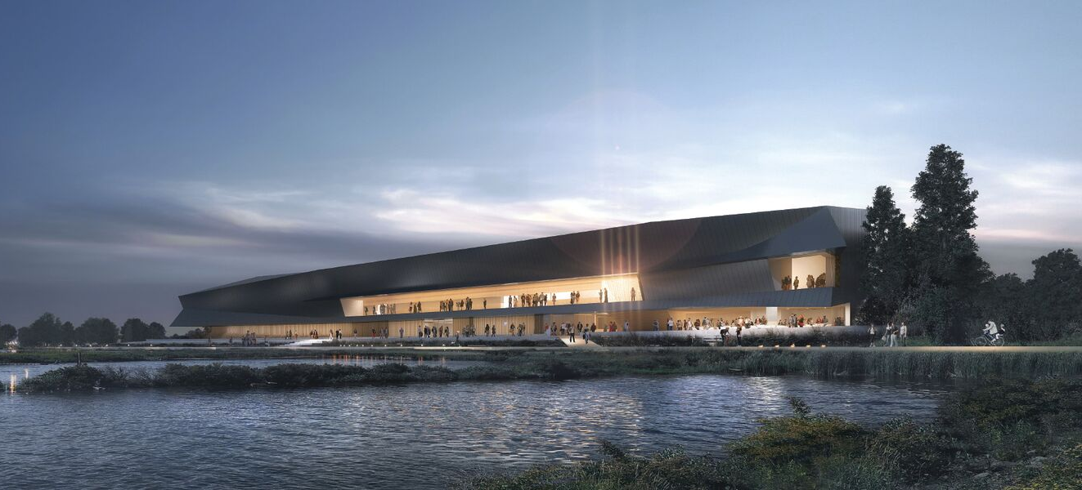
THANK YOU

