Slide 1
Strengthening
Northern Ontario’s Future
Ambassadors Northwest Presentation, January 8, 2026
Dr. Michael Green, President

Slide 2
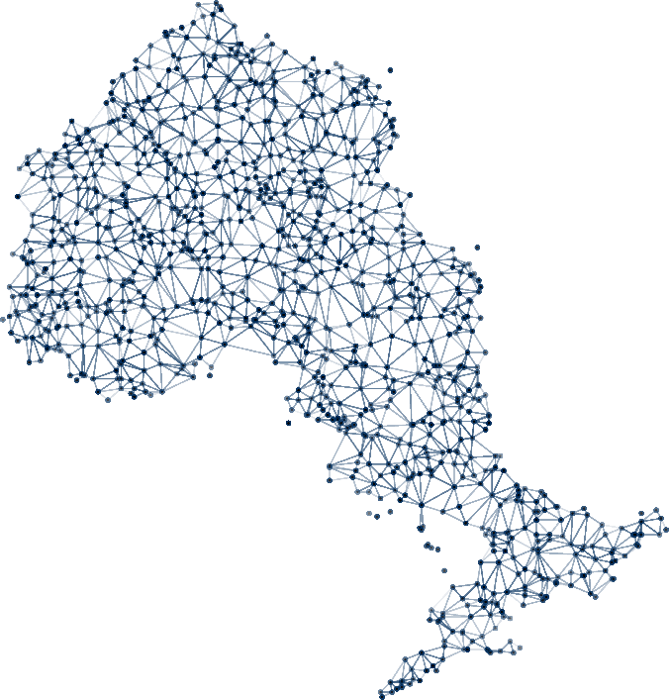
Territory Acknowledgement
We gratefully acknowledge the Elders and Knowledge Keepers who share their gifts and teachings with us so that we may better understand and honour their wisdom, and that of all Traditional Keepers of this land.
NOSM University will continue to practice reconciliation by listening, learning and fostering a culture of mutual respect and trust.

Slide 3

NOSM University celebrated 20 years in 2025
Twenty years of training doctors where Northern Ontarians live, work and raise families.
Canada’s only independent medical university
Created for Northern Ontario
Distributed medical education across more than 90 communities

Slide 4
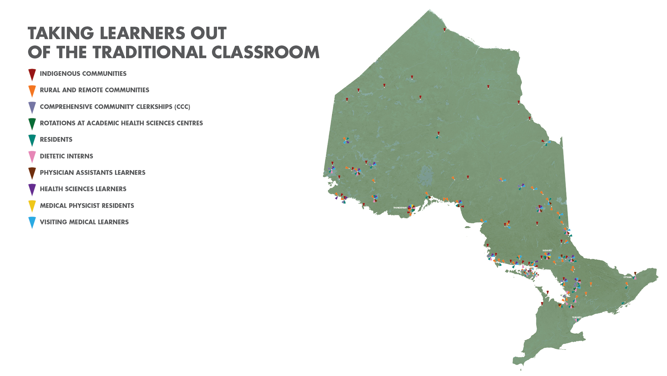



Slide 5
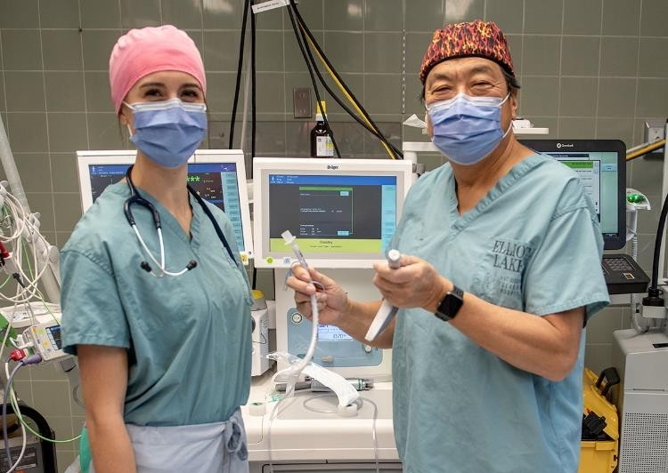
Expansion Ready and Student Success
Training in the North, by the North, for the North works.
Expansion will take place steadily over 5 years:
  UME: increase 64 to 108 by 2028.
  PGME: increase from 60 to 123 by 2028.

Slide 6
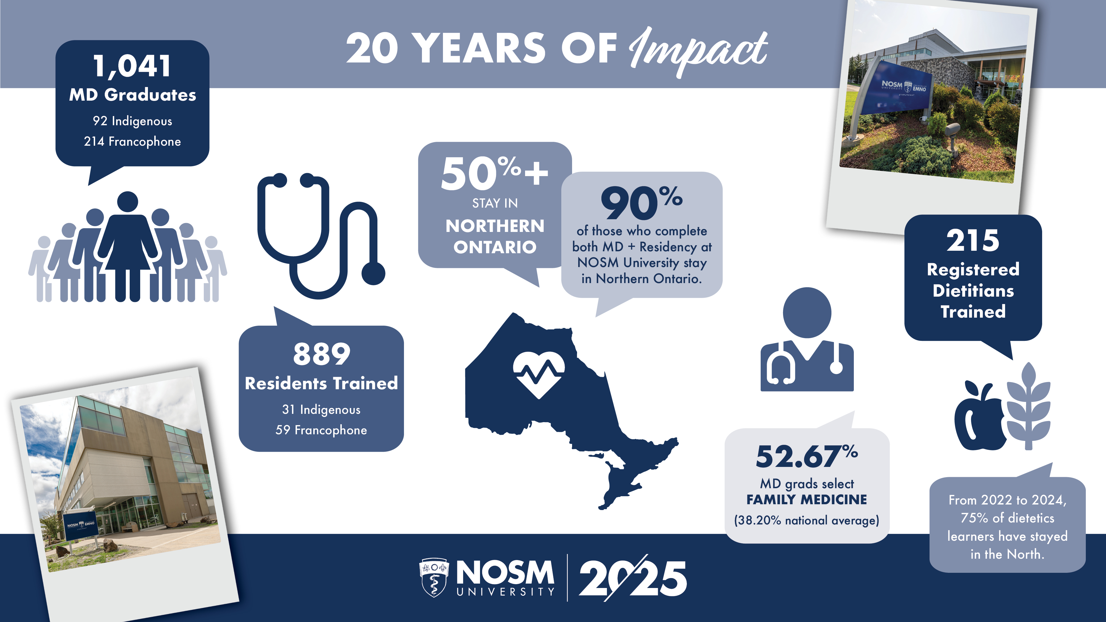
Sault Ste. Marie

Slide 7
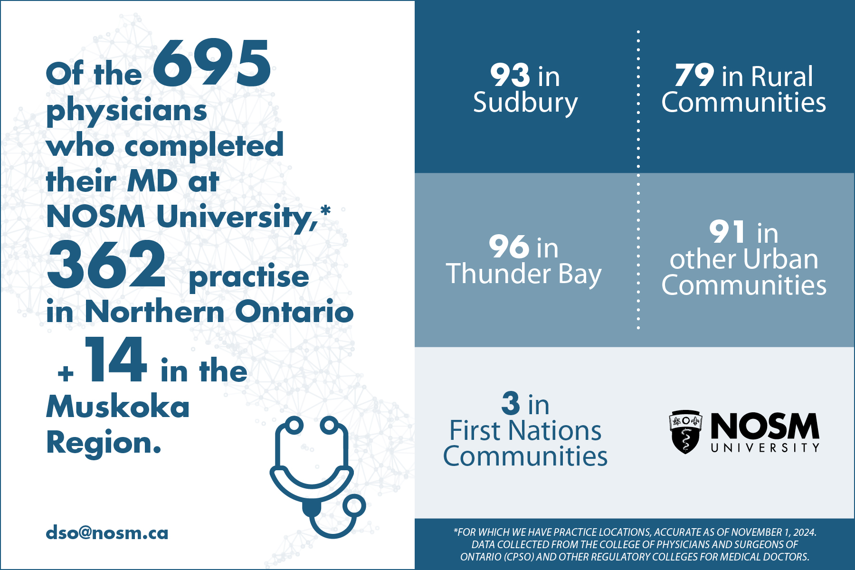
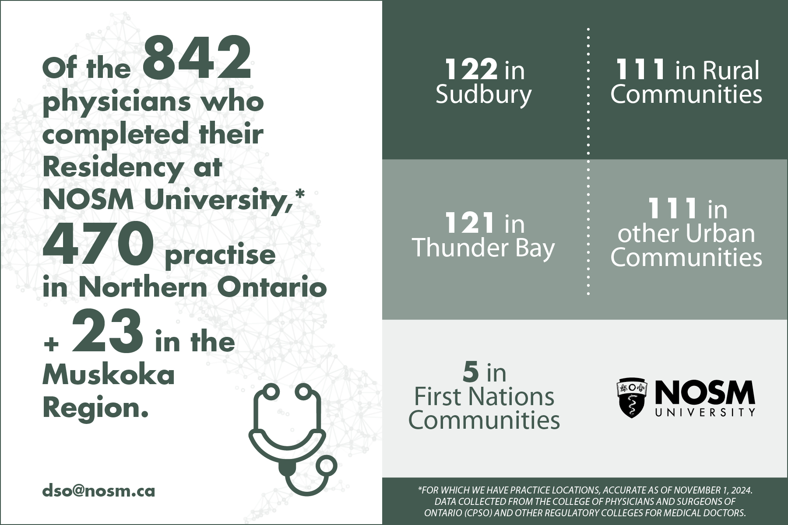
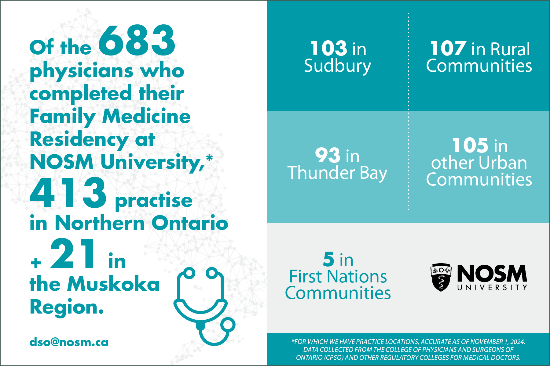
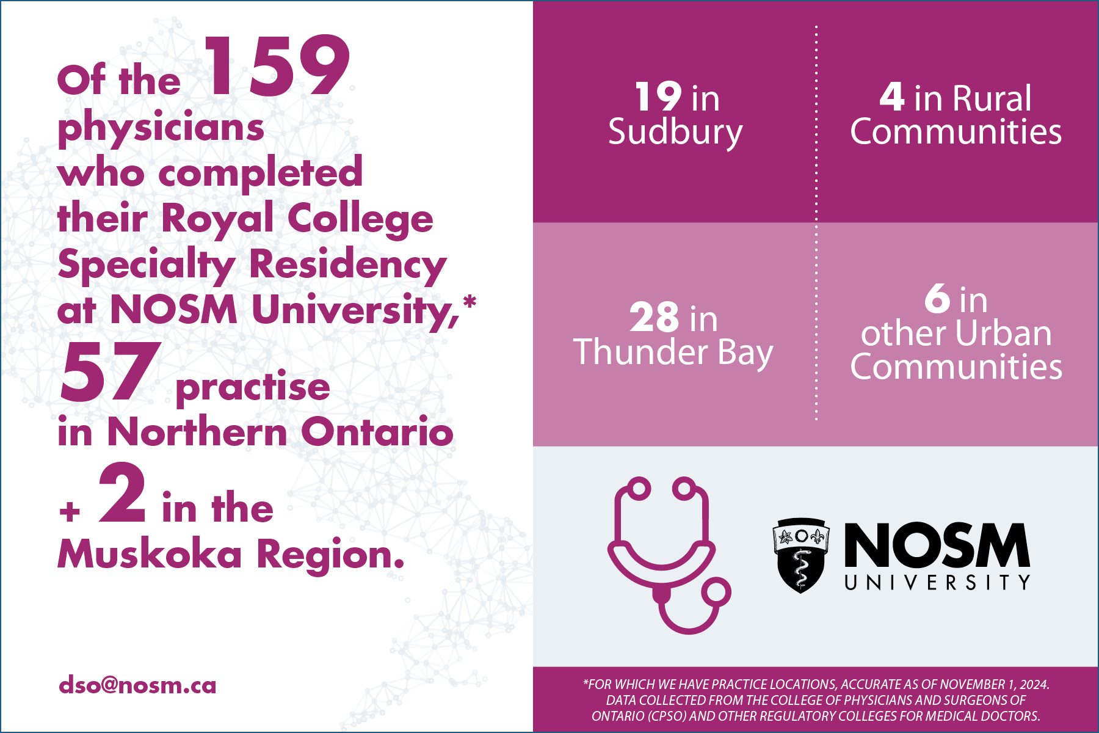
Success of NOSM University’s Model
Learners who completed their Medical Degree at NOSM University.
Learners who completed their Residency training at NOSM University.
Learners who completed Family Medicine Residency training at NOSM University practising in Northern Ontario.
Learners who completed Royal College Specialty Residency training at NOSM University practising in Northern Ontario.

Slide 8
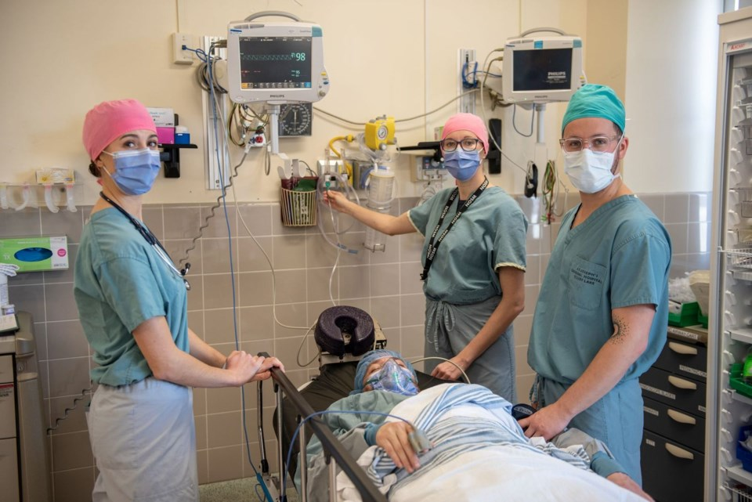
Rising demand. Growing expectations.
More people need primary care
More doctors are nearing retirement
Northern needs are becoming more urgent

Slide 9
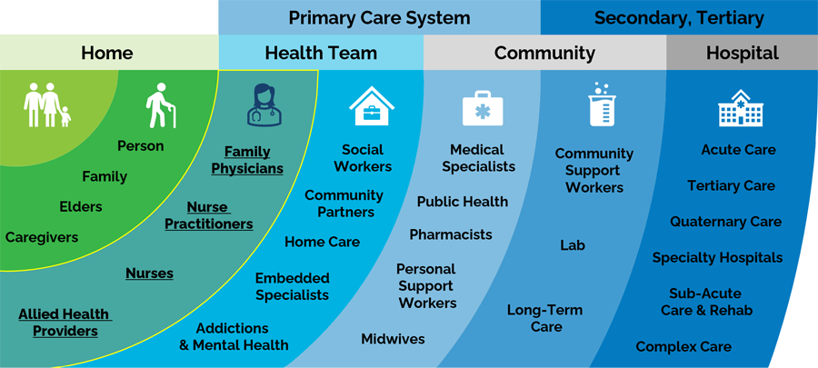
Provincial Direction: Primary care is the priority
Ontario’s Primary Care Action Plan depends on medical education capacity

Slide 10

A Structural Reality: Funding has not kept pace
NOSM University’s per-learner base funding has been frozen since 2004

Slide 11

A Shared Northern Conversation
Strong regions depend on informed leadership and shared understanding

Slide 12
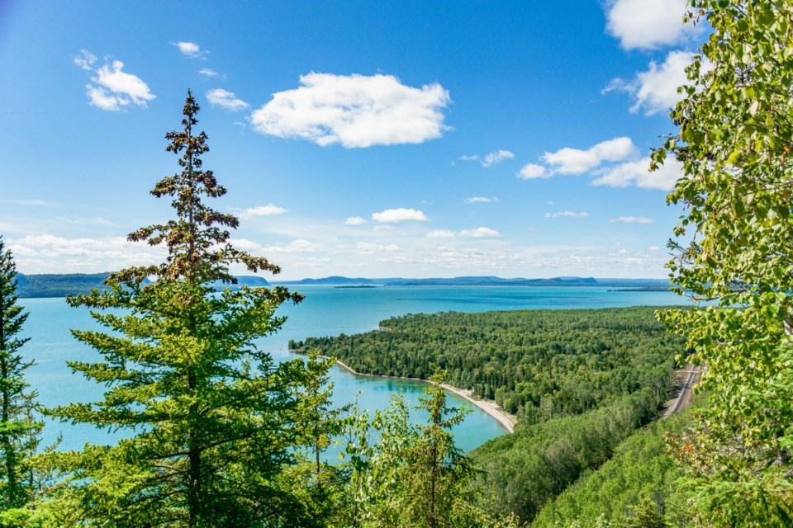
Strong health care supports strong regions
Northern solutions
Built in the North
Sustained together

