Slide 1
Making Thunder Bay a Leader in the Bio-economy
ACCELERATING INNOVATION IN THE BIOECONOMY

Slide 2
Who is CRIBE?
Formed in 2009 with initial 4 year mandate and funding commitment; mandate extended annually.
Catalyst for commercialization of research and innovation.
Focus on new products, processes, jobs and businesses using forest biomass.
Small lean organization with a senior experienced Board of Directors.
Project funding support up to 50% of project.
Close coordination with other research organizations.

Slide 3
CRIBE Mandate
Fund applied research, development and commercialization projects/partnerships related to the innovative use of forest biomass;
Coordinate and communicate strategically important knowledge and resources on how to navigate the innovation, entrepreneurship, marketing and export pathways in the bio-economy technologies sectors;
Facilitate innovative applied research and development that leads to the creation of products and processes that creates higher value commercial uses for the Province of Ontario’s forestry resources;
Accelerate commercialization by facilitating the creation and advancement of emerging companies;
Establish a strong network of collaborations across the sector.

Slide 4
PROJECT SPENDING
2009 - 2022
Forestry Innovation $300,000 Bioenergy $3,400,000 Biochemicals $14,000,000 Wood Products $4,000,000 Value Chain Development $1,000,000 Biocomposites $5,000,000

Slide 7
Unleashing Ontario’s Forest Product Potential
Where are we today…….

Slide 8
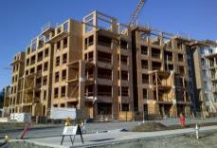
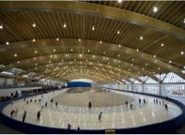
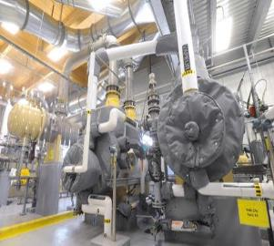
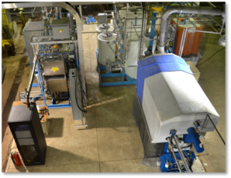
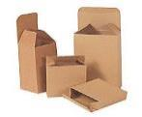
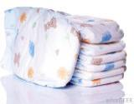
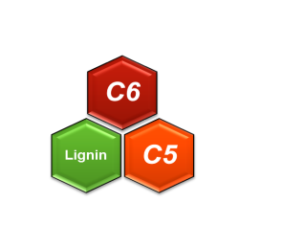
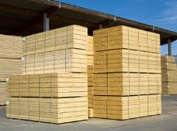
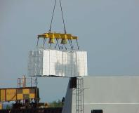
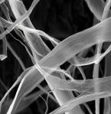
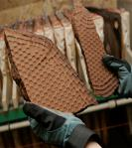
Forest Bioproducts: Creating Opportunities Beyond Traditional Markets
Creating Added Value ➔➔
Wood Products
Pulp & Paper
CNC
Chemicals
CF
Lignin
Sugars
Energy
Develop New Processes and New Materials ➔➔

Slide 9
Bioproducts Challenge – Integration!
Fossil-based
Feedstock
Fuels
Primary
Chemicals
End
User
Advanced
Manufacturing
Polymers
Chemicals
Finished
Products
Biomass
Feedstock
Biomaterials
How do we integrate into established, complex and fossil fuel dependent value chains??

Slide 10
State of Innovation/Commercialization
GAP
PROVEN TRACK RECORD

Slide 11
Elements for Successful Commercialization

Slide 12
Unleashing Ontario’s Forest Product Potential
…….Shared Collaboration is the key to success!

Slide 13
Making the Connection….
Since May 2018 CRIBE has conducted three workshops to discuss how to accelerate the forest bio-economy.
May 2018 – Ontario Cluster/Network Workshop Thunder Bay
August 2018 – Ontario Lignin Value Chain Workshop Toronto
December 2018 – Ontario Bio-adhesive & Resin Workshop Toronto
Key takeaway from each workshop:
Need for information sharing and collaboration along the value chain
Voice of Customer – better understanding of the needs across the value chain
Address the IP issue – identify open innovation and collaboration opportunities

Slide 14
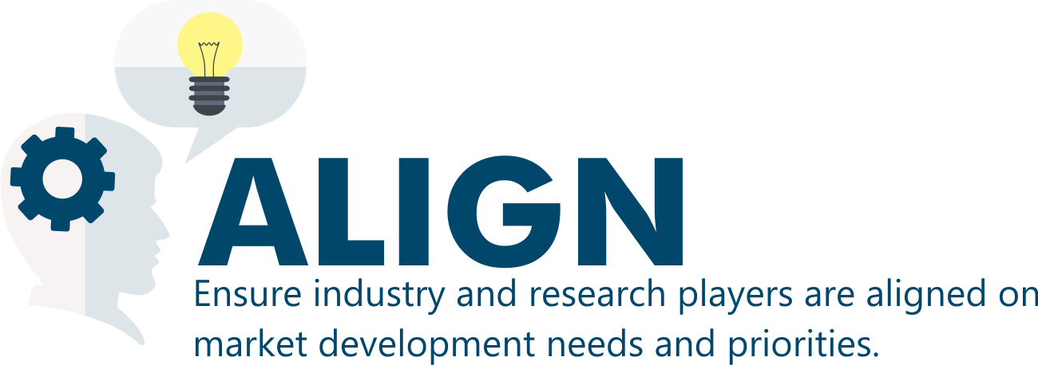
Collaboration as a Bridging Strategy

Slide 15
Value Chain Collaboration at Work Bio adhesive Forum Participation
Primary Industry
Tech Provider
Intermediate Producer
End User

Slide 16
Where does Thunder Bay fit??
A primary pillar of CRIBE’s original mandate was to support Thunder Bay to become a ‘bio-economy cluster’
CRIBE investment over $12 million directly in Thunder Bay based projects; leveraging over $46.8 million in investments;
FPInnovations BETC and 2 pilot plant facilities
Support to LU (BRI, Natural Resource Management, Chemical Engineering)
Support to Confederation College
SME support
Major Primary and Secondary Industry;
Transportation Infrastructure;
Highly Qualified People and Services;
World Class Research and Development;

Slide 17
Thunder Bay’s level of investment, skill set, facilities, mills, infrastructure and research capacity in the bio-economy are unparalleled globally!
YET
Product Development, Commercialization, New Business and Technology Development Leaders in the bio-economy field are investing elsewhere.

Slide 18
How do we put Thunder Bay on the map…….?
May 2018 – Ontario Cluster/Network Workshop Thunder Bay
February 2019 – Thunder Bay Cluster Workshop
March 2019 – Thunder Bay Cluster Workshop
Over 30 local stakeholders participated in each workshop, including representation from: Resolute, FPInnovations, Lakehead University, CEDC, Chamber of Commerce, FEDNOR, MNRF, NPI, NOHFC, Domtar, NRCAN, LDML First Nation, Greenmantle, PWU, OPG……

Slide 19
What we heard……Creating a Thunder Bay Cluster
Leadership: Need champions and endorsement from the major stakeholders in the community;
Ownership and Accountability: Community and bio-economy stakeholders must commit to working together;
Packaging: Develop the value proposition; what is Thunder Bay’s potential, create clear messaging and ensure consistent message from all partners (see above);
Facilitation: Need independent navigator to support and promote the bio-economy and stakeholders;

Slide 20
Next Steps
CRIBE will be taking a leadership role to collate the workshop findings into a clear call to action;
Looking for clear endorsement and support by local and regional executive leadership;
Further refine the Thunder Bay Forest Bio-economy value proposition;
Ensure all stakeholders are aligned and create the environment of shared collaboration;

Slide 21
Thank you
chris.walton@cribe.ca

