Slide 1


Slide 2

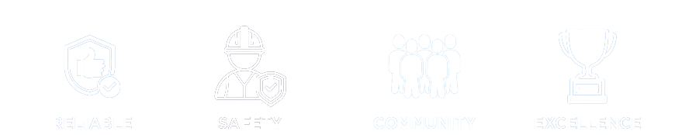
PURPOSE
We Power People’s Lives
VISION
Your trusted partner for energy and related services.
MISSION
Customers choose SYNERGY NORTH to power their lives with outstanding energy services delivered in a safe reliable and trusted manner to our communities.
CORE VALUES
Supply our products and services in a trustworthy, fair and dependable manner
Promote, work and live safely
Lead by example to build a strong community
Pursue being better in everything that we do

Slide 3

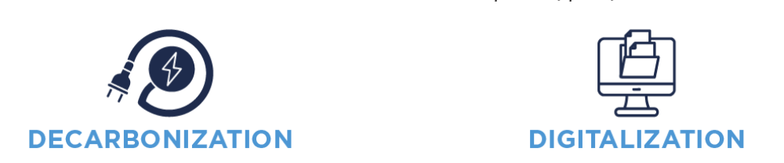

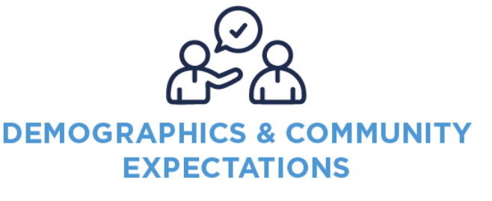
STRATEGIC CONTEXT
DECARBONIZATION
DIGITALIZATION
DECENTRALIZATION
DIVERSIFICATION
DEMOGRAPHICS
Climate change is accelerating the shift to net-zero.
Governments are advancing electrification across sectors.
Demand for electricity is rising and evolving.
Utilities must lead the clean energy transition.
Customers now produce, store, and manage their own electricity
Growth of distributed energy resources (DERs) is accelerating
Utilities must adopt new planning and operational approaches
Customers want advice, savings, and digital service
Demand for sustainable solutions is rising
Regulators pushing innovation and performance-based models
Utilities must adapt and partner differently
Enhanced reliability, efficiency, and outage response
Improve customer service and system monitoring
Increase cyber risk exposure
Investment in digital platforms, processes, and skilled staff
Competition amid flat population growth, especially in Northern Ontario
Utilities must be employers of choice and community leaders
Customers demand transparency, affordability, and local support
Strong focus on sustainability and reconciliation aligns with customer values

Slide 4


OUR ASPIRATIONAL GOALS
OUR STRATEGY
RELIABILITY
Grow our Grid
WE ARE BUILDING A MODERN GRID THAT SUPPORTS ELECTRIFICATION.
We continue to invest in the Distribution System Plan to prepare for a future driven by digitalization and evolving operational technologies. These efforts support reliability through strong business continuity practices, while reinforcing our focus on cybersecurity and risk management.
CUSTOMERS
Grow with our Customers
WE ARE A TRUSTED PARTNER THAT DELIVERS EXCEPTIONAL SERVICE.
SYNERGY NORTH is committed to delivering reliable electricity and related services with fairness, trust, and dependability. We focus on understanding customer needs, providing exceptional service, and maintaining a strong, visible presence in the communities we serve.
PEOPLE
Grow our People
A GREAT PLACE TO WORK AND GROW.
Our employees are essential to serving our customers, and their safety is our top priority. SYNERGY NORTH is a recognized leader in health and safety, committed to providing a safe, healthy work environment that extends into our employees’ personal lives and the communities we serve.

Slide 5
OUR 8 KEY INITIATIVES FOR GROWTH
1
SYSTEM
INVESTMENT
3
RISK:
BUSINESS CONTINUITY
Strengthening organizational resilience through cybersecurity, enterprise risk management, climate adaption, and supply chain strategy.
Continued infrastructure modernization, end-of-life asset replacement, and investment in system reliability to meet customer demand and enable electrification.
DISTRIBUTED ENERGY RESOURCES AND ELECTRIFICATION
2
ADVANCING
TECHNOLOGY
4
Accelerating SYNERGY NORTH’s digital transformation across customer tools, field technology, and system automation to support smarter operations and improved decision-making.
Preparing SYNERGY NORTH’S grid for increased DER participation, Electric Vehicle growth, and load changes with a customer-centric, cost-conscious approach.

Slide 6
OUR 8 KEY INITIATIVES FOR GROWTH
5
CUSTOMER EXPERIENCE
AND VALUE
WORKPLACE DEVELOPMENT
7
Developing and implementing a long-term HR strategy focused on leadership, operational alignment, DEI, and future-focused talent acquisition.
Enhancing customer engagement and communication, improving digital interfaces, and educating the public on SYNERGY NORTH’s value proposition and the energy transition
6
EMPLOYEE ENGAGEMENT
AND SAFETY
COMMUNITY PARTNERSHIP
8
Reinforcing a culture of safety and trust, improving internal communication, and providing platforms for employee voice and leadership development.
Formalizing external relationships with municipalities, First Nations, and institutions to drive economic development, inclusivity, and regional collaboration.

Slide 7

LOOKING AHEAD
Our 2025–2028 Strategic Plan builds on our commitment to safe and reliable service; rooted in the needs of Thunder Bay and Kenora and shaped by employee and stakeholder input.
Through this plan, we will:
Deliver essential investments in system renewal, reliability, and DER readiness
Advance a culture of innovation that integrates smart tools, customer insights, and digital operations
Support electrification and growth while ensuring affordability and long-term value
Strengthen community partnerships and create new opportunities for collaboration
Lead with safety, accountability, and purpose
SYNERGY NORTH remains committed to operational excellence and affordability.

Slide 8


Slide 9


VISION
Create enduring value through sustainable growth and positive community impact.
MISSION
We offer full service and trusted solutions that help customers meet the challenges of energy transition.
OUR ORGANIZATIONAL VALUES
SUSTAINABILITY
INTEGRITY
COLLABORATION
COMMUNITY
SAFETY
A compelling vision for a sustainable energy future
Delivering customer focused solutions in a trustworthy, fair and dependable manner
Working together to rise to energy challenges and find affordable solutions
Strengthening our communities through growth and giving back
Our top priority is to work and live safely

Slide 10

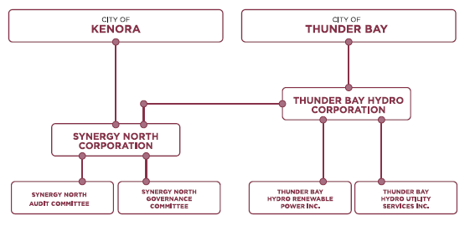
CORPORATE STRUCTURE
As the Corporation evolves, current offerings will expand and new operating companies will be considered to support growth in emerging sectors.

Slide 11


Our Strategy – Innovation, Energy Transition, Trust
CAPACITY AND CULTURE
WE ARE BUILDING A COMPANY THAT IS READY TO ACT
Hydro Corp is evolving from a legacy structure into a modern holding company focused on sustainable value and transformative infrastructure. Through strategic investments in governance, leadership, and internal systems, we are building an agile, entrepreneurial culture that embraces innovation and is equipped to drive growth.
ENERGY TRANSITION
WE GROW THROUGH ELECTRIFICATION, ENERGY TRANSITION AND BY OFFERING COMPLETE SOLUTIONS
Positioned to lead the shift toward net-zero infrastructure, Hydro Corp is expanding into consulting, advisory, and project delivery services. We are helping clients implement electrification strategies and are investing in energy projects that align with decarbonization goals and long-term financial sustainability.
CUSTOMERS
WE ARE A TRUSTED COMMUNITY PARTNER THAT DELIVERS EXCEPTIONAL VALUE AND SERVICE
Hydro Corp’s strategy is centered on meeting changing customer needs and strengthening community well-being.

Slide 12

THE PATH FORWARD
Hydro Corp’s inaugural Strategic Plan sets a disciplined path for sustainable growth, public value, and long-term financial performance. It reflects our readiness to lead a portfolio of companies delivering critical infrastructure, energy solutions, and innovation.
We will implement core initiatives, build internal capacity, and engage stakeholders to ensure transparency, alignment, and accountability throughout the journey.
We will modernize governance, advance electrification and renewables, and strengthen community partnerships. Hydro Corp will be strategically positioned for long-term growth.
Align with the Smart Growth Action Plan and other leading organizations to help drive growth in Northwest Ontario
Above all, Hydro Corp will remain grounded in its dual purpose: to be a trusted community asset and a platform for responsible, enduring growth.

