Slide 1
The State of Real Estate in Thunder Bay
Ambassadors Northwest
Thursday, March 14, 2019
Jack Mallon

Slide 2
Residential Real Estate
  Numbers
  New builds
  How do we compare?
  What sells/what doesn’t
  Residential tax rates versus rest of the province
  Bedroom community deficits re: CEDC strat plan for mining

Slide 3
Residential Real Estate
More Canadians are now living alone more than ever before. Thanks in part to rates of divorce, an unprecedented 1 in 6 persons are now living alone *
Winnipeg sales are up 6% as buyers adapt to new mortgage rules
                Statistics Canada

Slide 4
Mortgage delinquencies rose 1.5% in the final quarter of 2018
GTA home sales continued their year over year decline in February (mortgage stress tests)

Slide 5
Top Brokerage Comparisons

Slide 6
Commercial/Industrial Real Estate
What’s happening
Opportunities
Land availability
Tax comparisons with province

Slide 7
Analysis of building permits (2013-17)
 | Residential | Commercial | Industrial | Institutional | Total
2017 | 46,005,135 | 47,723,913 | 7,396,291 | 42,265,088 | 143,390,427
2016 | 37,958,950 | 28,538,989 | 4,696,600 | 22,594,844 | 93,789,383
2015 | 45,325,464 | 37,331,400 | 2,404,400 | 72,489,548 | 157,500,812
2014 2013 | 52,462,315 60,870,170 | 26,994,450 57,542,300 | 4,486,600 9,491,500 | 19,411,200 84,087,300 | 103,354,565 211,991,270

Slide 8
Getting the private sector (you) involved
Ambassador Waterfront Committee
City Land Development Committee
Ground needs attention
Today’s proposal

Slide 9
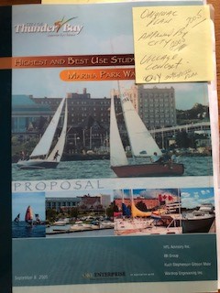
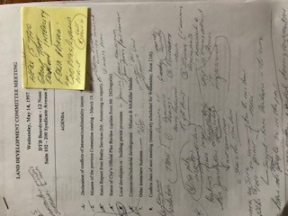
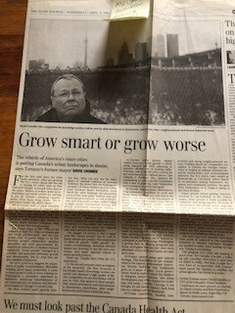
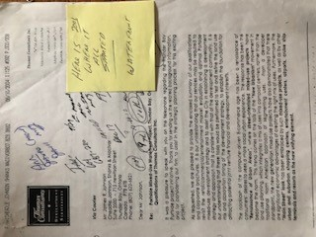
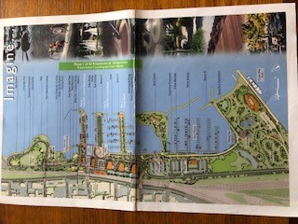

Slide 10
Questions/Comments?

